Slide 1

CSE- 4105
Lecturer-09
Projection-I

Slide 2
Three dimension
Three-dimensional space is a geometric 3-parameters model of the physical universe (without considering time) in which all known matter exists.
Z
Z-Coordinate
Y
X
X-Coordinate
Y-Coordinate

Slide 3
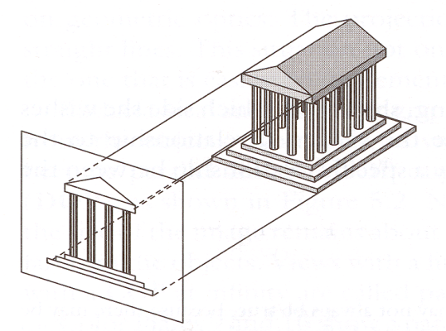
Three dimension
3 Dimensional Object : An object that has height, width and depth, like any object in the real world is a 3 dimensional object.
3D Graphics : In computers graphics, 3-D (three dimensions or three-dimensional) describes an image that provides the perception of depth/height/width.

Slide 4
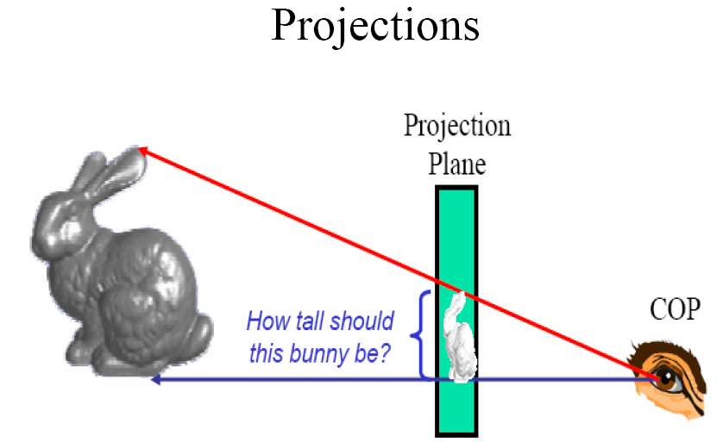
Projection

Slide 5
Projection
Projection
  Transformation from n-D coordinate system to m-D coordinate system, where m < n
Our concern
  n = 3 and m = 2
  ⇒ projection from 3D to 2D

Slide 6
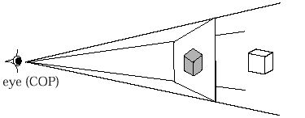
What Are Projections?
Our 3-D scenes are all specified in 3-D world coordinates
To display these we need to generate a 2-D image - project objects onto a picture plane
So how do we figure out these projections?
Picture Plane
Objects in
World Space

Slide 7
Converting From 3-D To 2-D
Projection is just one part of the process of converting from 3-D world coordinates to a 2-D image
3-D world coordinate output primitives
Clip against view volume
Project onto projection plane
Transform to 2-D device coordinates
2-D device coordinates

Slide 8

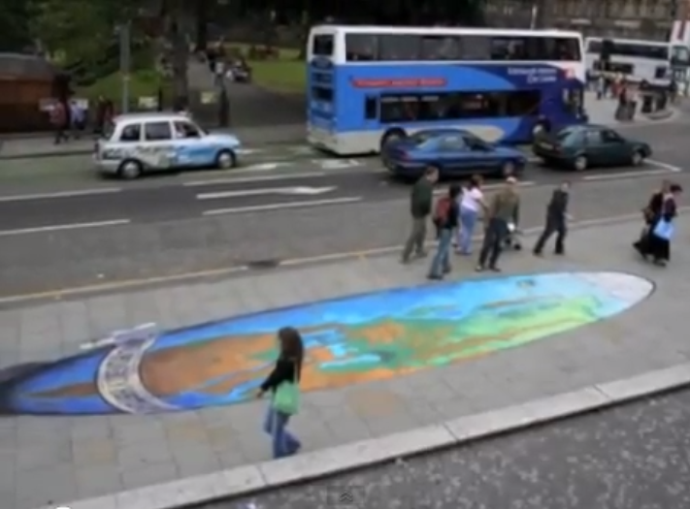
Projection

Slide 9
Projection Geometry
Plane of Projection
Object Point
P
Projector
P’
Center of Projection
P (3D)
P’ (2D)

Slide 10
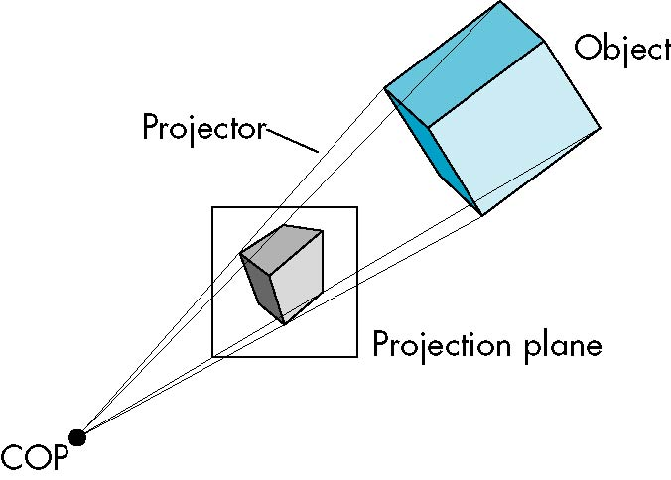
Projections
Terminology
  Projectors: Straight projection rays
  Center of projection: Where the projectors emanated from
  Projection plane: Where the projection forms

Slide 11
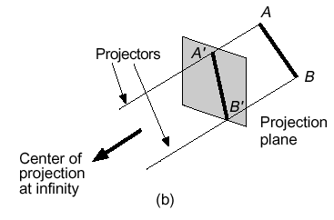
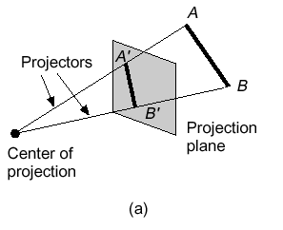
Types Of Projections
There are two broad classes of projection:
  Parallel: Typically used for architectural and engineering drawings
  Perspective: Realistic looking and used in computer graphics

Slide 12
Perspective
Perspective is a technique applied in drawing and painting to give a flat surface or imagery a sense of depth.
Horizon is the line for which the sky meets the land of water below. The height of the horizon will affect the placement of the vanishing point(s) as well as the scene’s eye level.

Slide 13
Perspective
Vanishing point is the point where parallel lines appear to come together in the distance. A scene can have a limitless number of vanishing points.
The diagonal lines are lines which are directed to a vanishing point.
The ground plane is the horizontal surface below the horizon. It could be land or water.

Slide 14
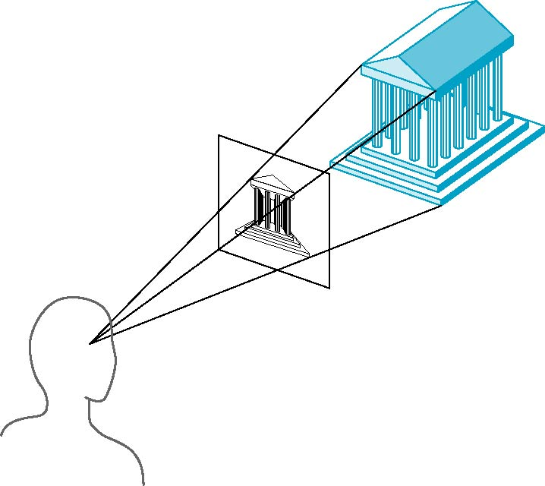
Perspective
Perspective is all about DEPTH
Determined by center of projection
Distance between projection plane and COP is finite
Visual effect similar to human visual system
  Perspective foreshortening:
  Distance from COP longer, size smaller
  Exact shape, measurement, parallelism not reserved

Slide 15
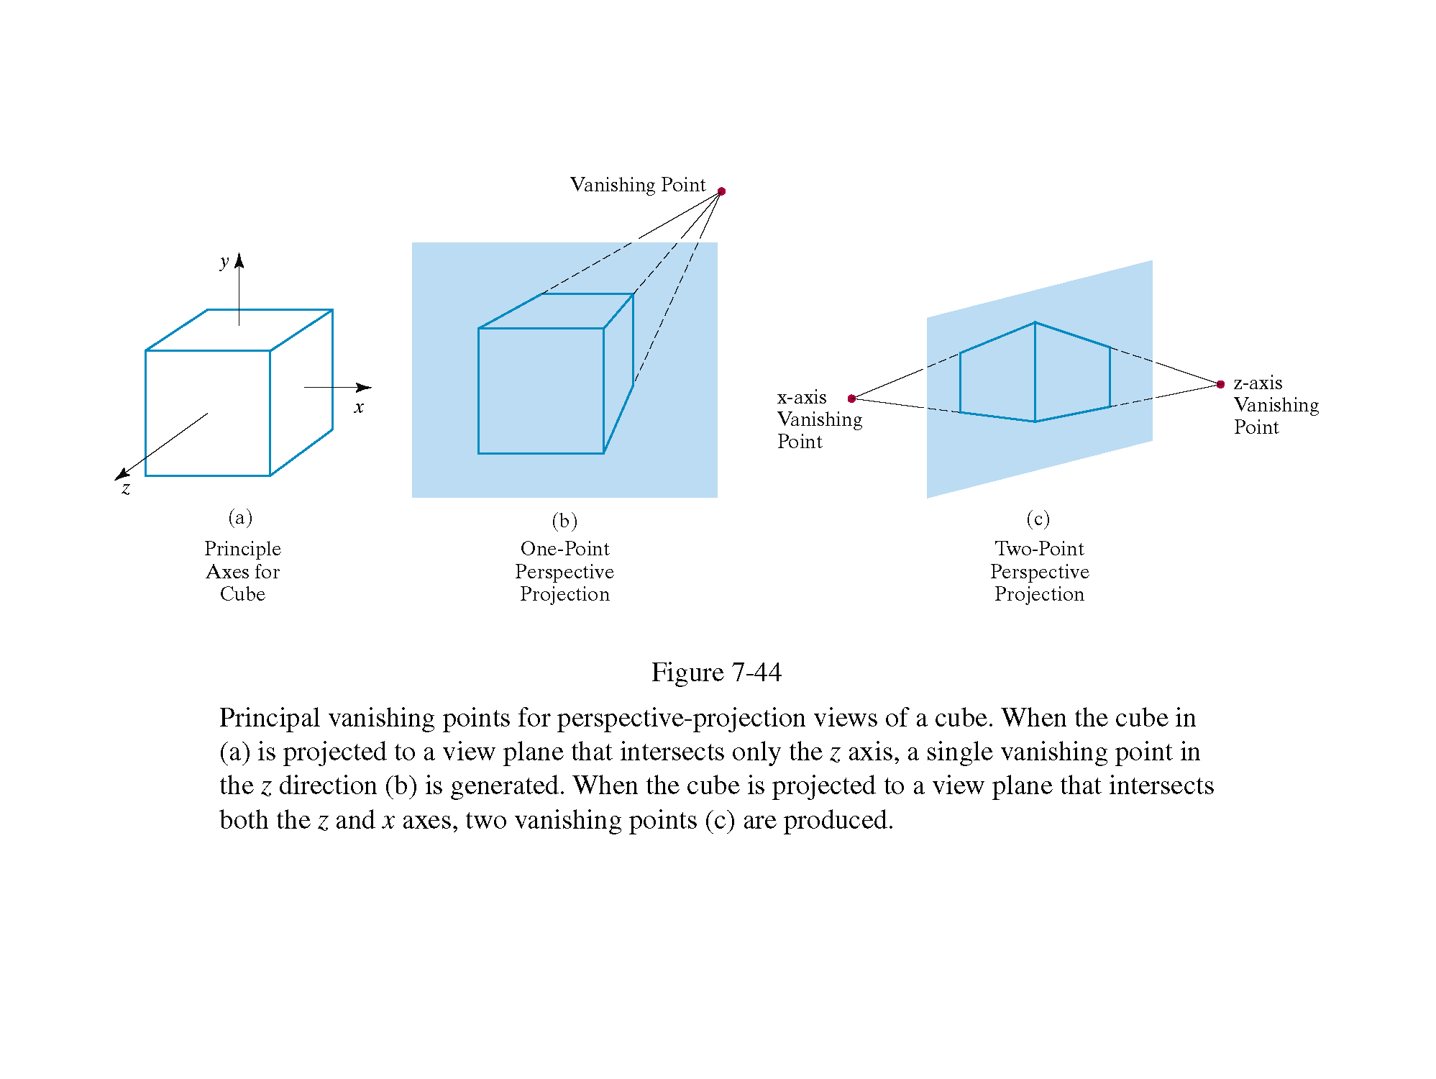
Perspective Projections
There are a number of different kinds of perspective views
The most common are one-point and two point perspectives

Slide 16
Vanishing Points
Parallel lines (not parallel to the projection plane) on the object converge at a single point in the projection (the vanishing point)
Drawing simple perspectives by hand uses these vanishing point(s)
vanishing point

Slide 17
Vanishing Points
Parallel lines (not parallel to the projection plane) on the object converge at a single point in the projection (the vanishing point)
Drawing simple perspectives by hand uses these vanishing point(s)
vanishing point

Slide 18
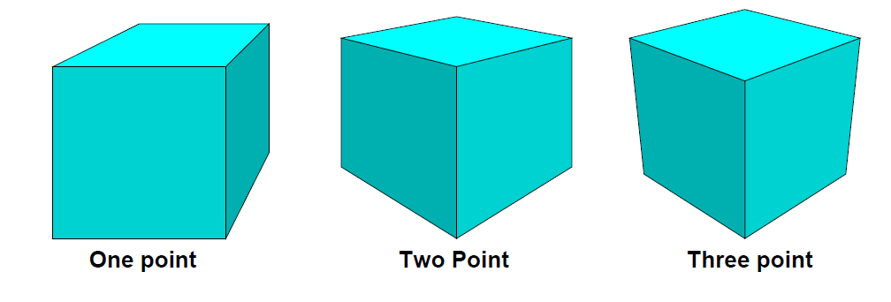
One-Point Perspective
One point perspective rule applies when your subject is viewed on the front.
Ex- a side of a cube or a face looking directly at you.
One principal face parallel to projection plane
One vanishing point for cube
Used when drawing rooms,
roads and landscape.

Slide 19
Two-Point Perspective
Two point perspective is a linear perspective that uses two vanishing points, and is associated with DEPTH and WIDTH.
Senses in this type of perspective have the vanishing points placed at the far left and far right.

Slide 20
Three-Point Perspective
Three point perspective is similar to two-point perspective, it has left and right vanishing points on the horizon.
Additionally, there is a third vanishing point either below or above the horizon.
Principal face parallel to projection
Plane and associated with DEPTH,
WIDTH and HEIGHT.

Slide 21
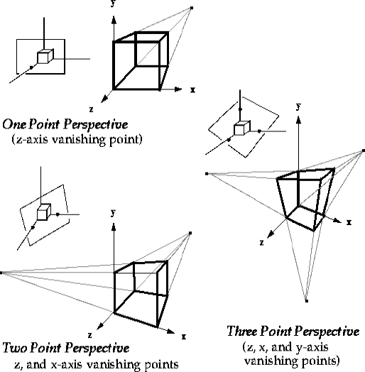
Vanishing points

Slide 22
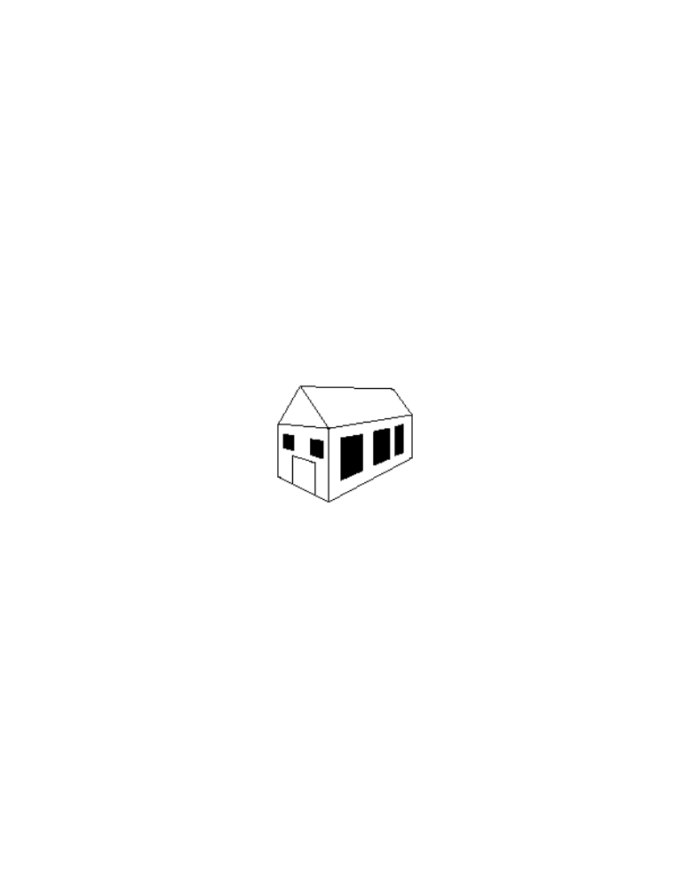
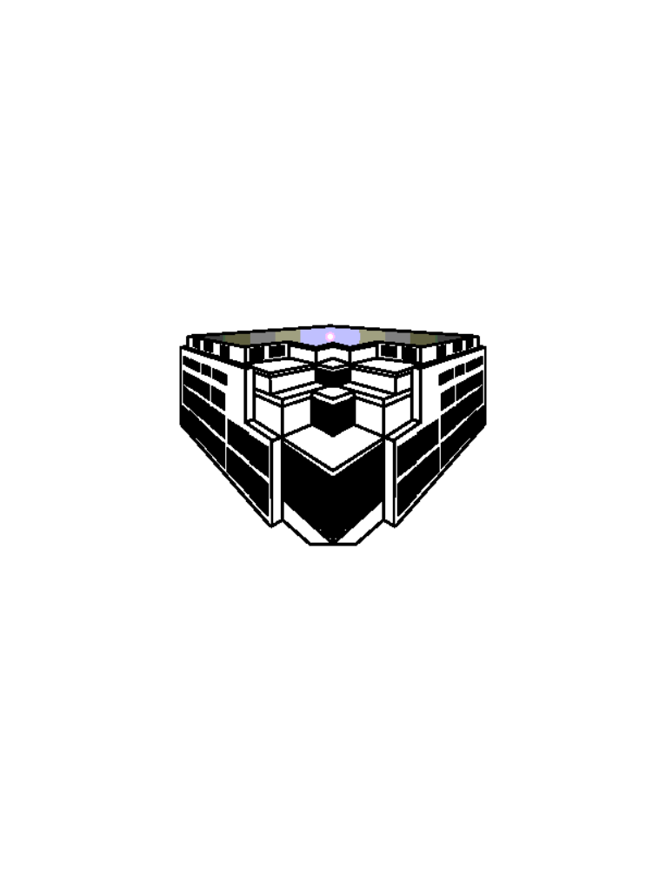
Perspective Projections
Used for:
  Fine Art
  Human visual system…
Pros:
  Gives a realistic view and feeling for 3D form of object
Cons:
  Does not preserve shape of object or scale (except where object intersects projection plane)

Slide 23
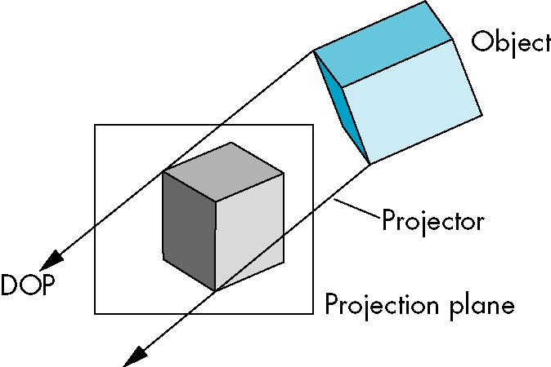
Parallel Projections
Determined by direction of projection
Distance between projection plane and COP is infinite
Less realistic view
  No foreshortening
Exact measurement and parallelism preserved

Slide 24
Parallel projections
For parallel projections, we specify a direction of projection (DOP) instead of a COP.
There are two types of parallel projections:
  Orthographic projection – DOP perpendicular to PP
  Oblique projection --- DOP not perpendicular to PP

Slide 25
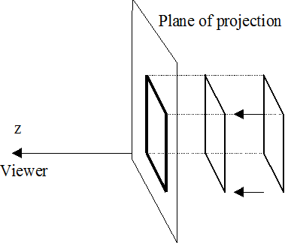
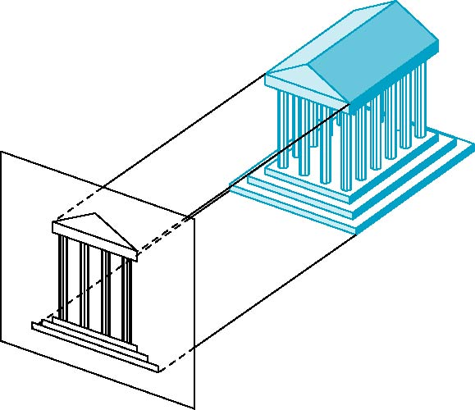
Orthographic Projection
The lines of projection are parallel, and at the same time orthogonal to the plane of projection.
Project onto plane by dropping that
coordinate;
All rays are parallel.

Slide 26

Multiview Orthographic Projection
Projection plane parallel to principal face
Usually form front, top, side views
isometric (not multiview
orthographic view)
front
side
top

Slide 27
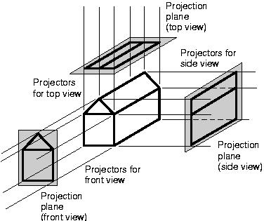
Orthographic Parallel Projections

Slide 28
Advantages and Disadvantages
Preserves both distances and angles
  Shapes preserved
  Can be used for measurements
    Building plans
    Manuals
Cannot see what object really looks like because many surfaces hidden from view
  Often we add the isometric

Slide 29
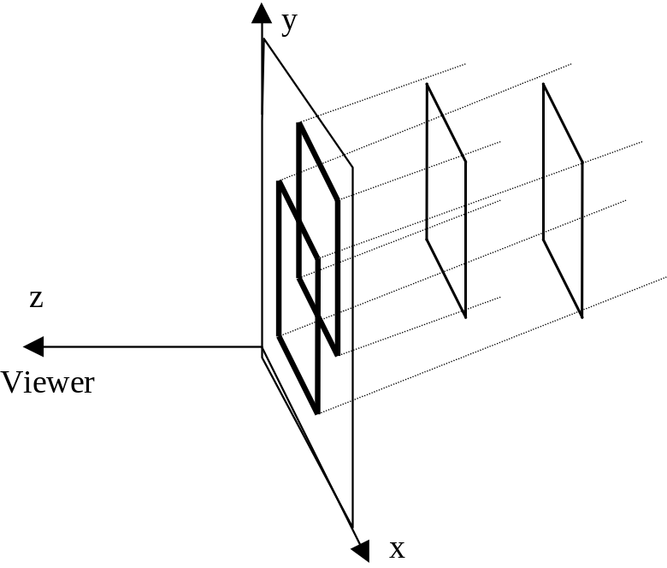
Oblique Projection
The lines of projection are parallel, but not orthogonal to the plane of projection.

Slide 30
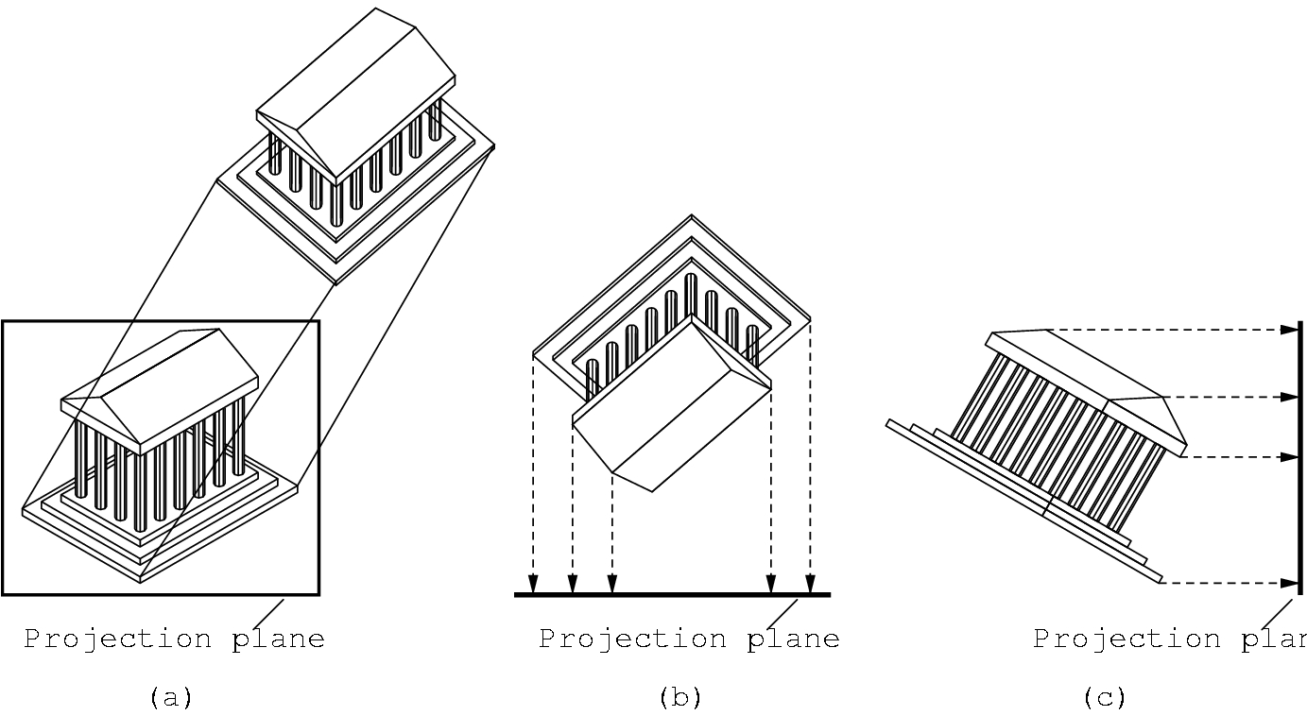
Oblique Projection
Arbitrary relationship between projectors and projection plane
The projectors are still orthogonal to the projection plane
But the projection plane can have any orientation with respect to the object.
It is used extensively in architectural and mechanical design.

Slide 31
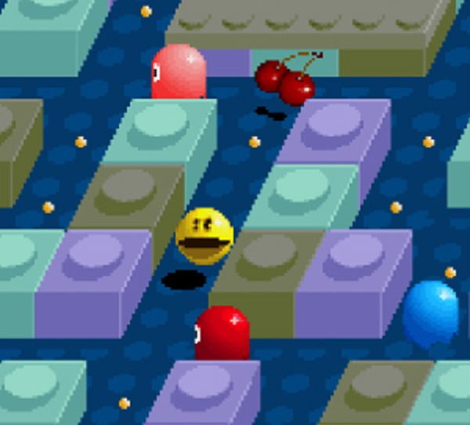
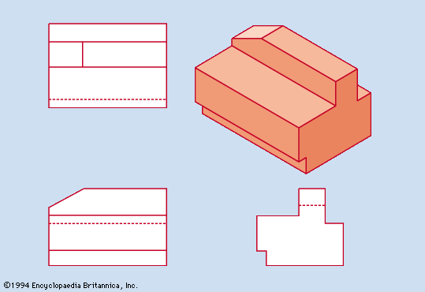
Advantages and Disadvantages
Can pick the angles to emphasize a particular face
  Architecture: plan oblique, elevation oblique
Angles in faces parallel to projection plane are preserved while we can still see “around” side

Slide 32
Parallel and Perspective
Parallel Projections:
  The center of projection is at infinity.
  The projectors are parallel to each other.
Perspective Projections:
  The center of projection is a finite point.
  The projectors intersect at the center of projection.

Slide 33
Projections: Properties
Projections map points from one space to another coordinate space of lower dimension, and hence involves loss of information.
Projections are not invertible. All projection matrices are singular.
All points on a projector map to the same point on the plane of projection.

Slide 34
For better understanding
https://www.youtube.com/watch?v=1miyDqc0bsg

Slide 35
Thank You

